Slide 1





Musical micro:bit
Teacher lesson guide
Lesson 2

Slide 2
Learning objectives:
To use existing knowledge to improve programs.
To write and debug musical programs.
To experiment with the micro:bit to make music.

Slide 3
Writing algorithms
Discuss with your partner:
What was the goal of the algorithms we wrote last lesson?
Who was the intended audience of the algorithms?
How could our algorithms be improved?

Slide 4
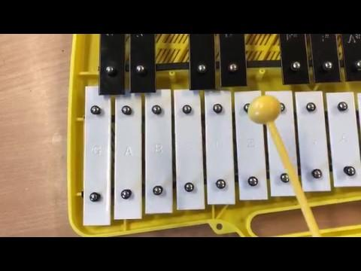
Represent that tune
Represent the algorithm someone who cannot read music might have used to play this musical phrase.
Use the points from your evaluation last session.
https://youtu.be/grKPI8fZ8yw

Slide 5
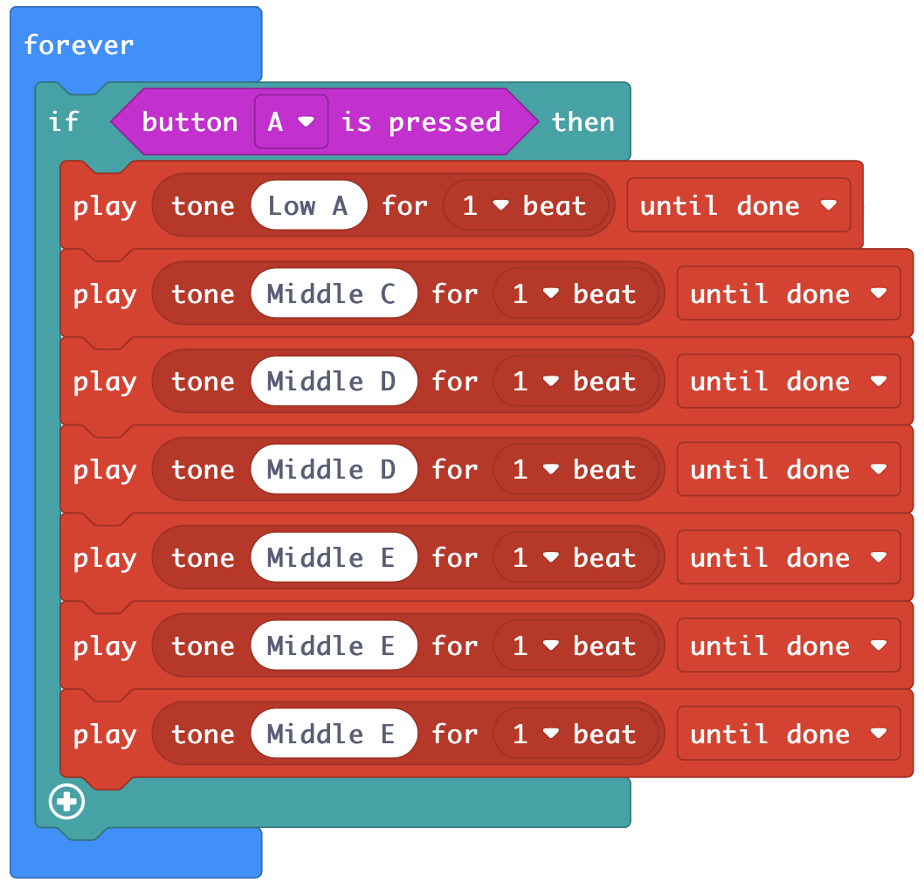
Reading programs
What statements can you make about this program?
Which blocks have/haven’t we used before?
Which computing concepts are being used?
How could you improve this program?
https://makecode.microbit.org/_407eMmEy9Ciu
Notes:
When button ‘a’ is pressed the the musical phrase a, c, d, d, e, e, e will be played.
The use of ‘forever’ means the computer is constantly checking to see if button ‘a’ has been pressed.
The music blocks (red) may be new to the students.
Selection is being used because the computer will only carry out the actions when button ‘a’ is pressed.
Inputs are being used as button ‘a’ is an input.
Repetition is being used as the program is checking forever if button ‘a’ has been pressed.
The program can be improved by using repetition (loops) to state how many times to play d and e instead of using a new block for each note.

Slide 6
Reviewing programs
Explain how you wrote a program with the same musical phrase using fewer blocks.
What computing concept were you making use of?
Why is it more effective to use this concept?
Notes:
Using repetition means we use fewer blocks therefore the program is quicker to write and there are fewer blocks to check when debugging.

Slide 7
From algorithms to programs
Use the MakeCode editor to program each of your musical phrases.
Each musical phrase should start with a different input. Why?
Remember to test and debug your program as you work.

Slide 8
Making the micro:bit musical
When your program works, download and transfer it to your micro:bit.
Use the equipment provided to work out how to get the micro:bit to play the musical phrases.
Use the image on the next slide to help you.
Hint: accuracy is very important!

Slide 9
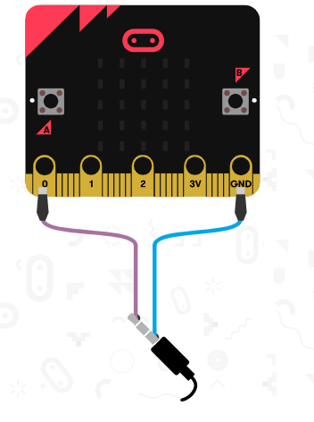
Making the micro:bit musical

Slide 10
Learning objectives revisited:
To use existing knowledge to improve given programs.
To write and debug musical own programs.
To experiment with the micro:bit to make music.

Slide 11
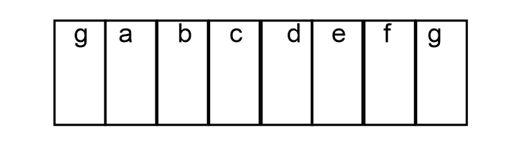

Slide 12
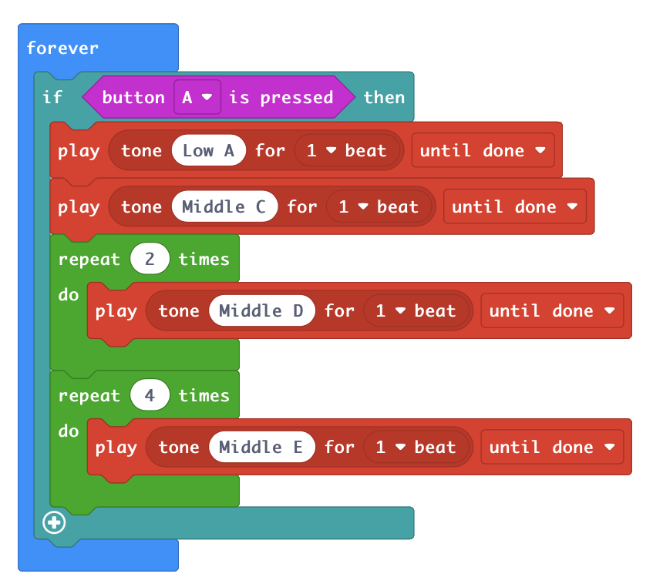
https://makecode.microbit.org/_aVp4eogoWDA1

